Slide 1
Quiz App
By: Patrick Snow
Computer and Information Sciences
Prof. Sean Hayes

Slide 2
Statement of Purpose
An app that can be used for almost anything such as studying, games, and a personality quiz.
It will have an online capability so everyone can enjoy quizzes made by others.
It will have limitless amounts of quizzes that people can interact with.

Slide 3
Research, Background, and Project Language
The main research that was needed was learning how to work with Flutter and Firebase (online cloud database storage).
I also had to learn dart, flutter packages, dependencies, widgets and how to structure the quiz app to work the way it's intended to.

Slide 4
Project Requirements
A login and sign up page, with hidden password text field to prevent shoulder surfing.
An authentication that will make sure the user correctly signs up with a legitimate email and lengthy (min: 6 letters) password.
An authentication that will check with the firebase database for registered users so they can log into the app.
A function that will allow the user to make their own quiz and view quizzes made by others.

Slide 5
Project Description
The app will prompt a login or register page.
The authentication determines if the input is correct for login or register of the user.
The home page displays quizzes from the database.
The home page supplies a button that will take the user to the page where the user can create their own quiz.
In order to make a quiz, the user needs an img URL, quiz title, and quiz description before the quiz questions page.

Slide 6
Project Description (con.)
The quiz questions page will prompt the user to enter a question with four answers (The first is the correct answer).
After the user finishes adding questions then user can click the submit button which will then send all of the strings to the database.
Each quiz in the database is separated in a document.
Next, the quiz goes through a file that will read the created quiz data and form a quiz onto the app.
A logout button is supplied for the user to sign out.

Slide 7
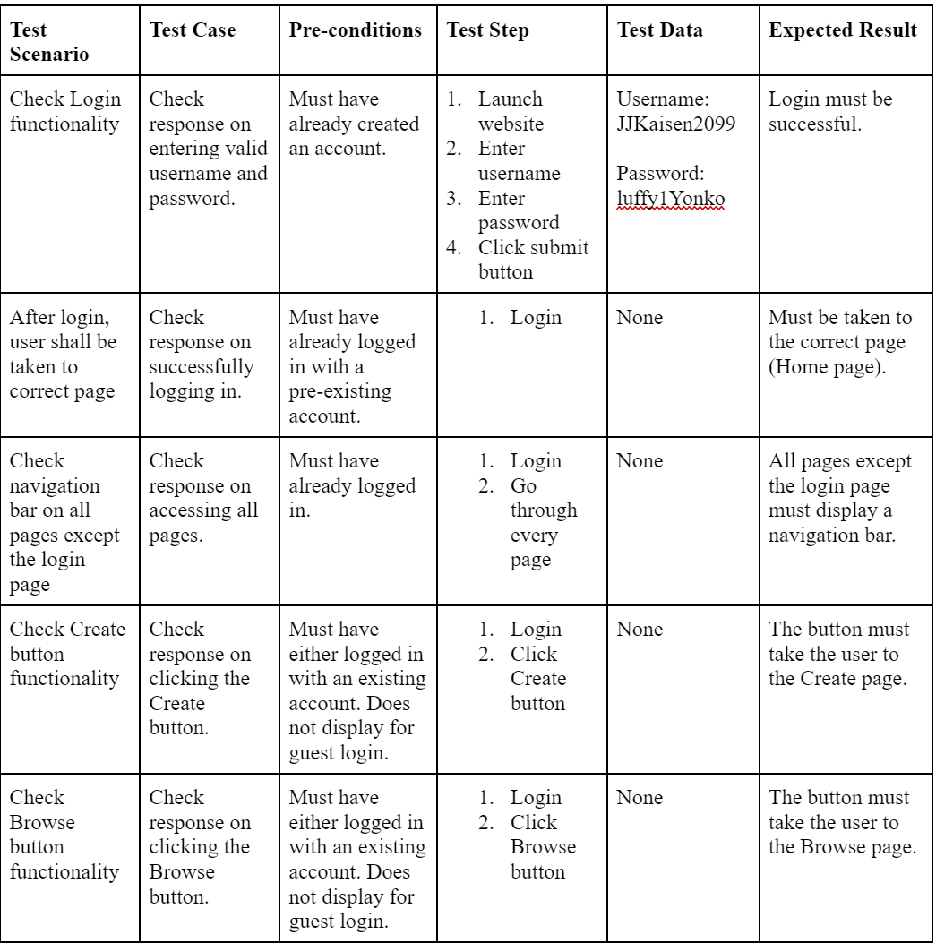
Test Plan
Make sure the authentication for login and register functions correctly.
The quiz making process functions as desired in the project description.

Slide 8
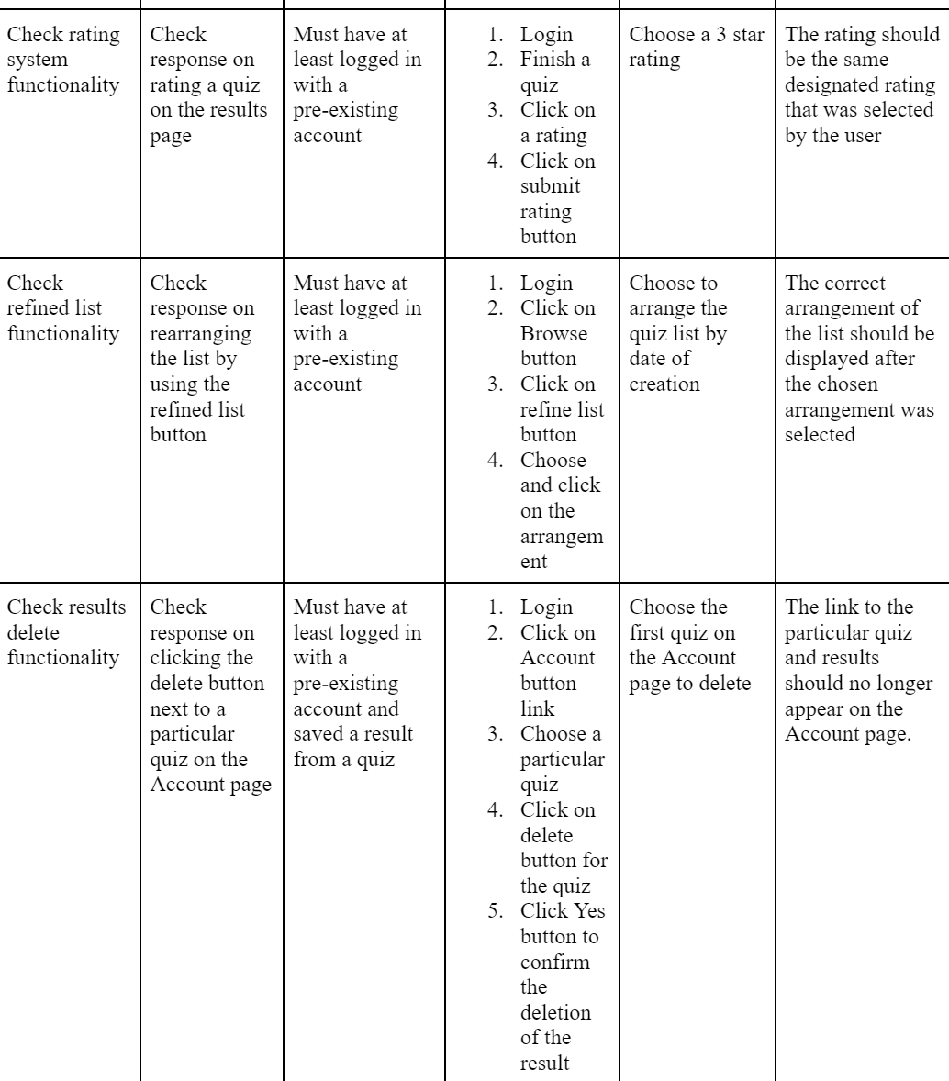
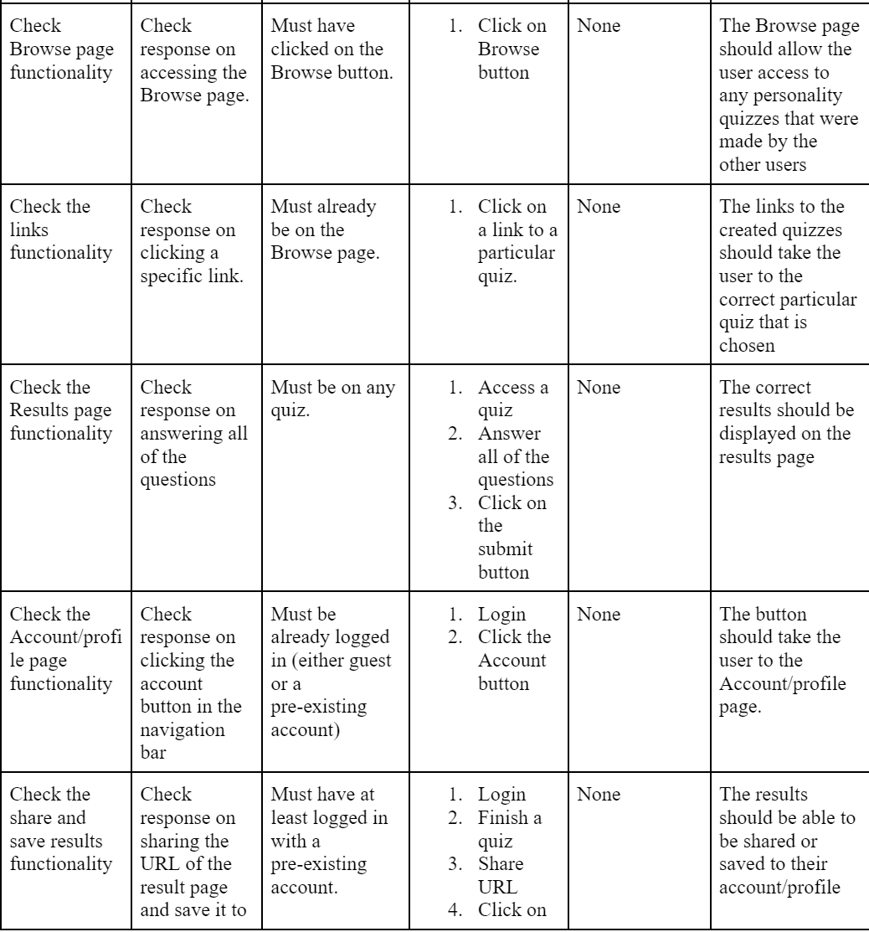
Test Plan (con.)

Slide 9
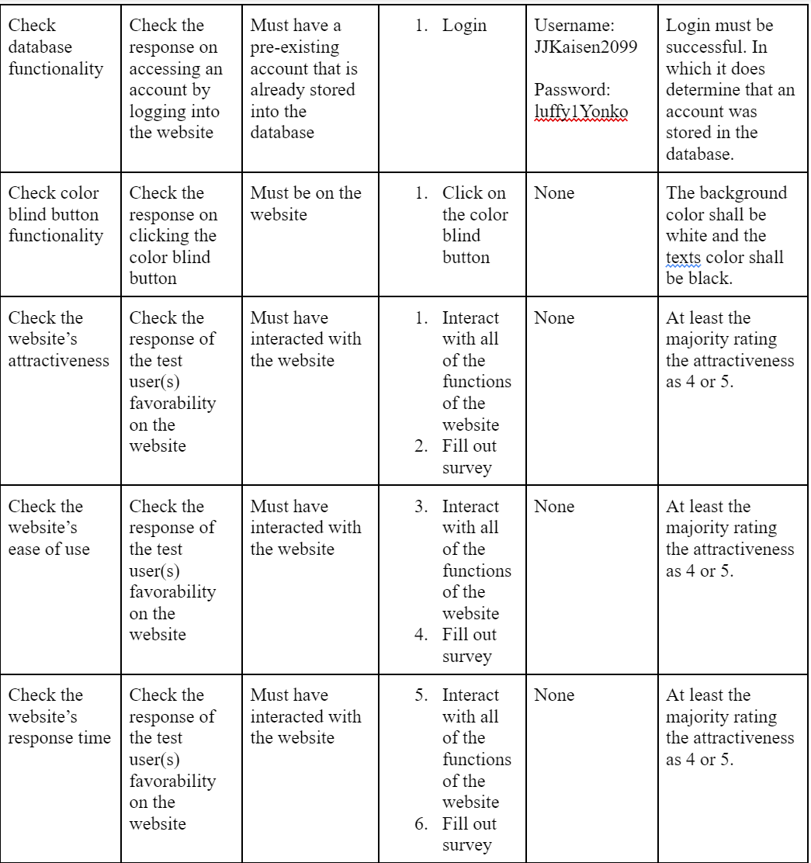
Test Plan (con.)

Slide 10
Challenges Overcome and Future Enhancements
It was definitely harder and needed a lot more time to work on certain pages.
Learning Flutter and Firebase took longer than expected due to the big update that occurred on May from 2.0 to 3.0.
There were a lot of changes and it was harder to find resources or lessons on how to code with the most current syntaxes needed.
Better UI
Search function
Sharing with friends
Log in with social media logins

